Slide 1
POWER ENJOY
RASD: REQUIREMENTS ANALISYS AND SPECIFICATION DOCUMENT
Stefano Brandoli, Silvia Calcaterra, Samuele Conti

Slide 2
GOALS and SUBGOALS
[G1] Allow users to find available cars and reserve them
[G1.1] Allow users to access the system
[G1.2] Allow users to find available cars
[G1.3] Allow users to reserve available cars
[G2] Allow users to use the reserved cars in the city area
[G2.1] Manage the user reservation
[G2.2] Handle unexpected car situations and user behavior
[G3] Guarantee a uniform distribution of the cars in the city area
[G4] Incentivize users to use properly the reserved cars
[G4.1] Reward the users that ease the experience of other users
[G4.2] Penalize the users that ruin the experience of other users

Slide 3
S2B BOUNDARIES
-Name: VehicleInterface
-Mnemonic: Car
-Name : Google Maps
-Mnemonic: MapsService
-Name : Virtual POS
-Mnemonic: BillingService

Slide 4
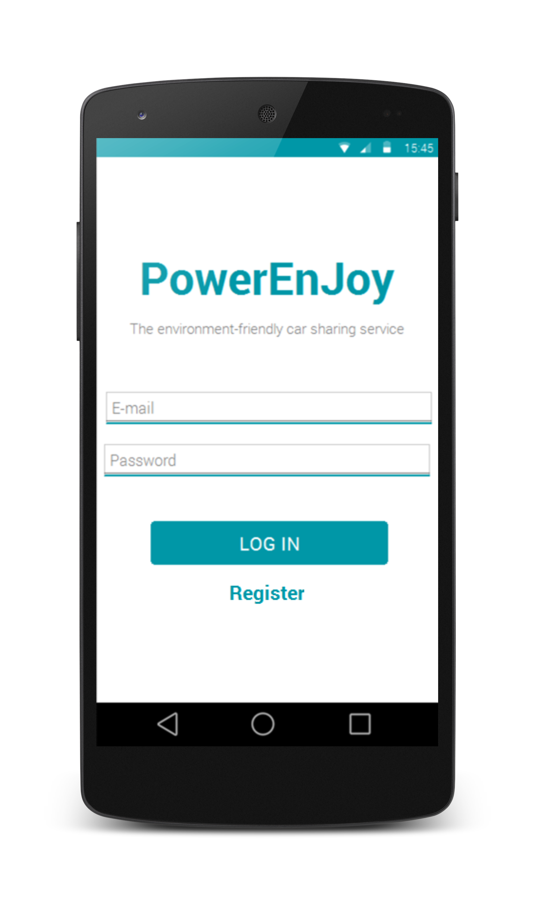
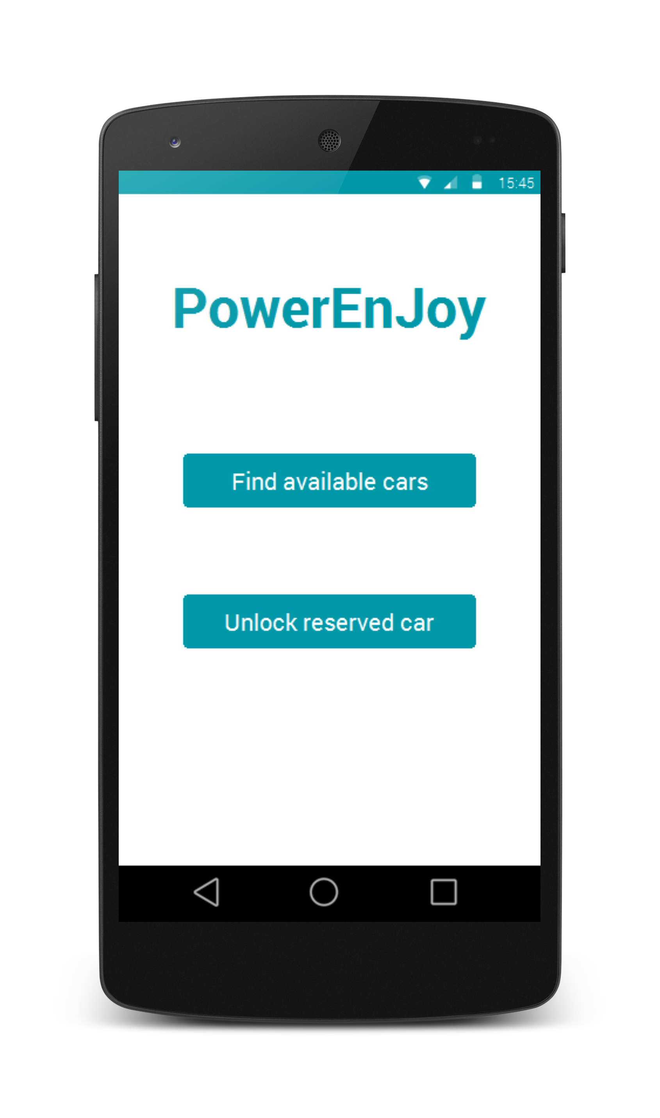
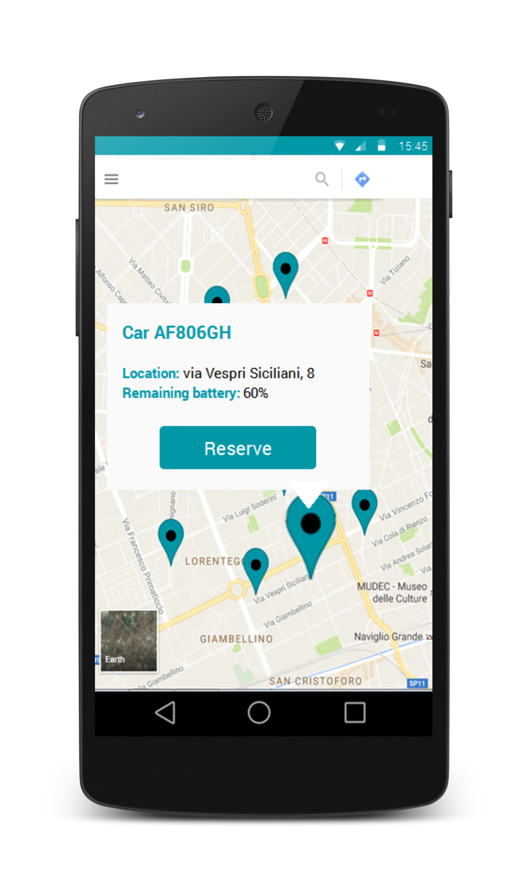
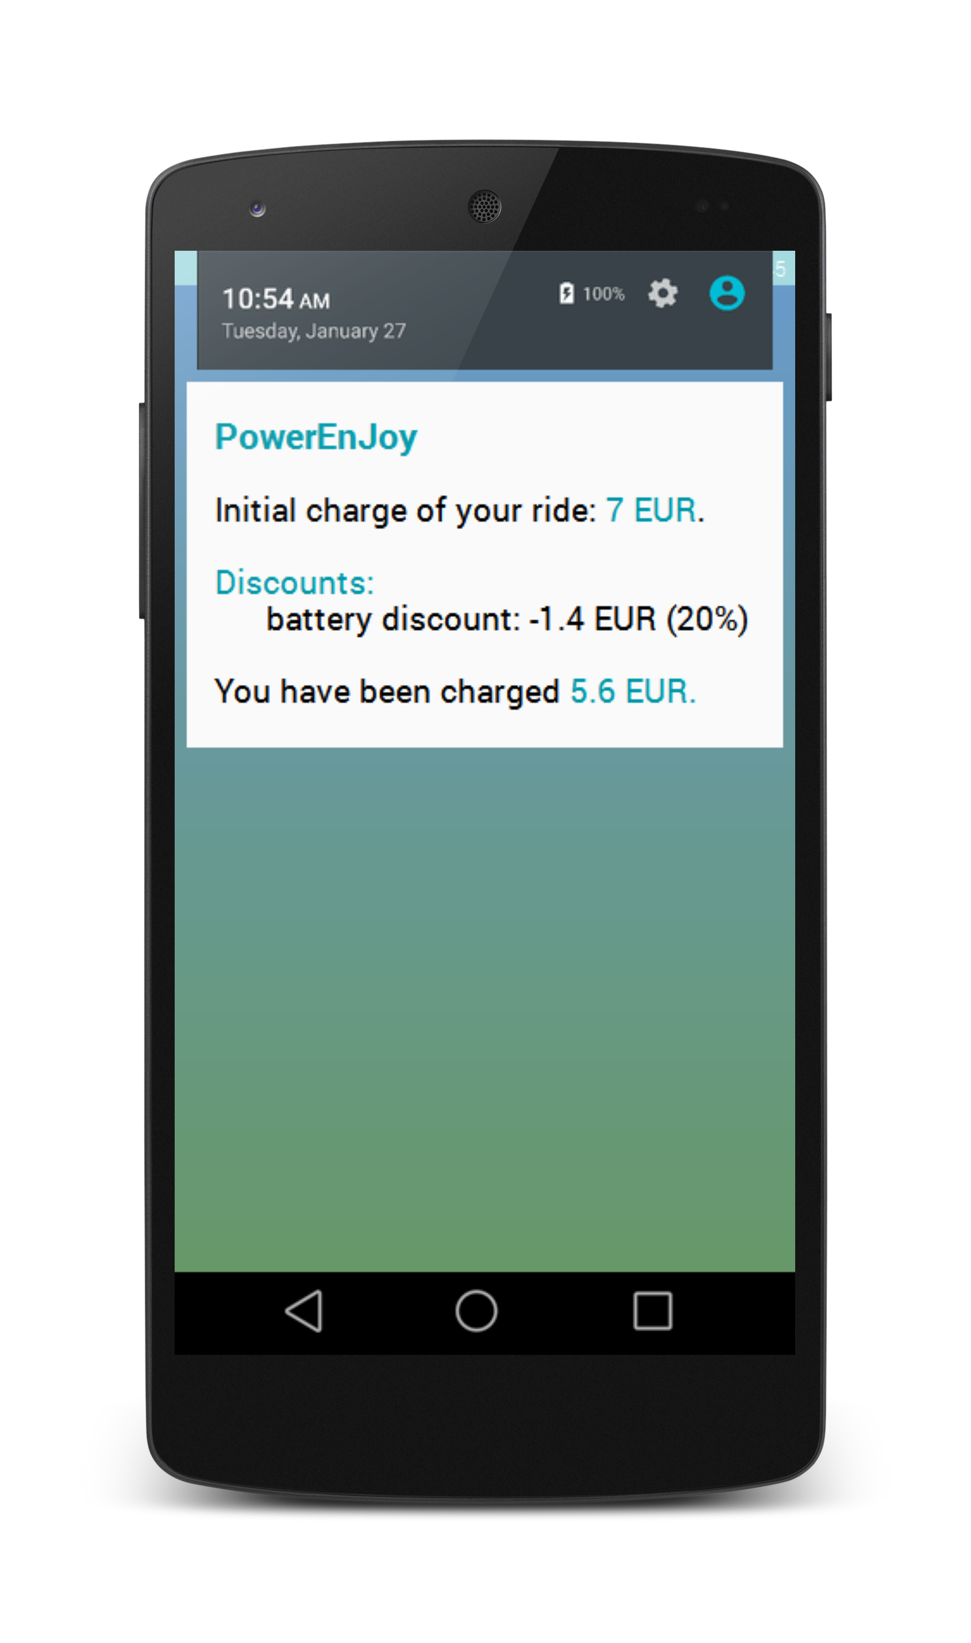
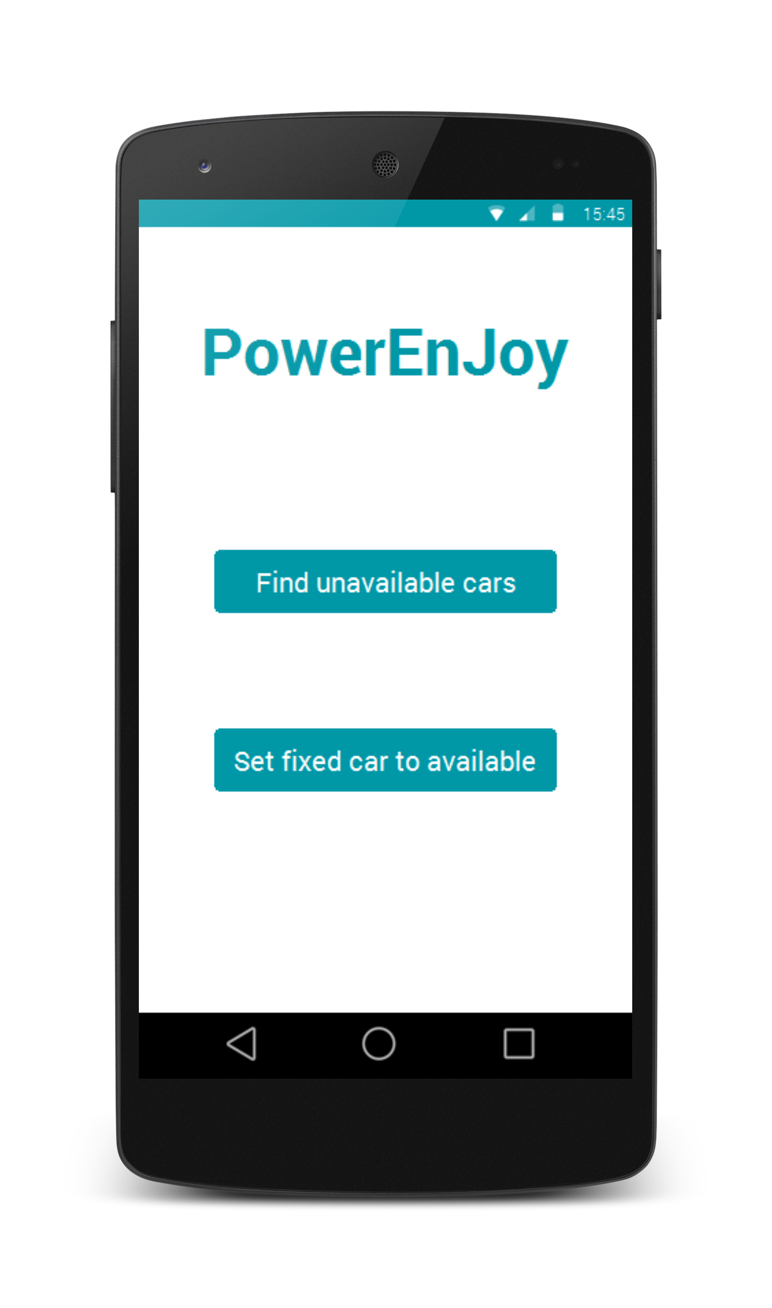
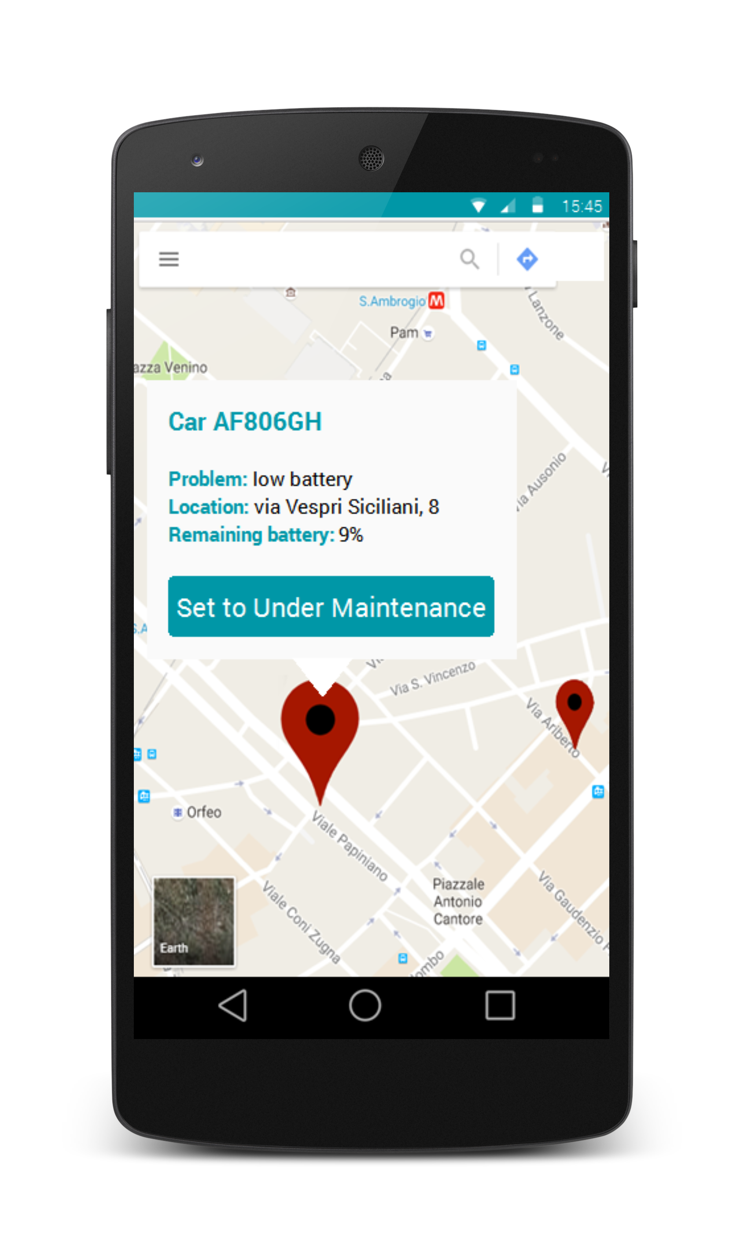
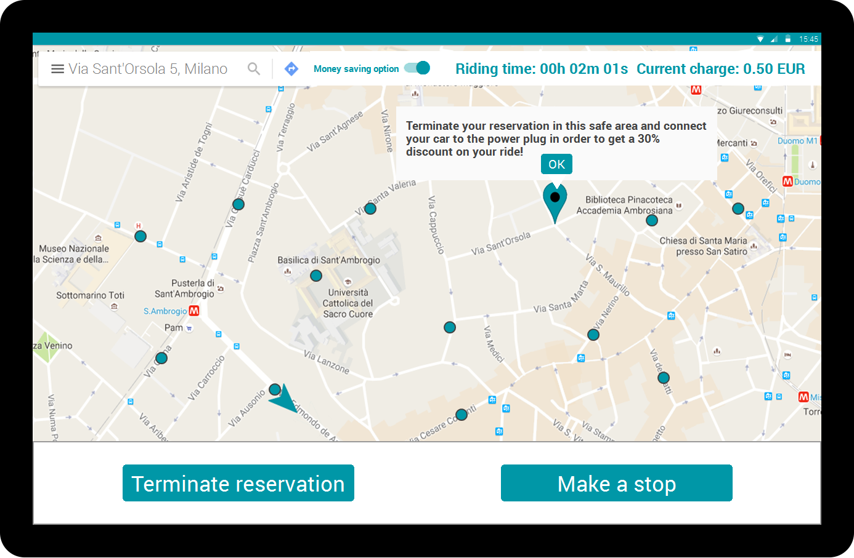
MOCKUPS

Slide 5
SOME ASSUMPTIONS...
[D1] Every car has a GPS module that is always on.
[D2] Every car has a 3G module that is always on.
[D3] The S2B on board of a car is always on even when the screen on board of that car is turned off to save service battery energy.
[D4] Inside every car there is a low-level hardware board which is connected to the CAN-bus of the car. This board provides a software interface that can be used by our S2B to get informations from that car and to control the actuators of that car.
[D8] A car occurring in a car failure will always be able to communicate to the system.
……
[D15] When a car is plugged to a power plug inside a power safe area, the battery array recharges and the service battery recharges as well.
Users are unpredictable!!!

Slide 6
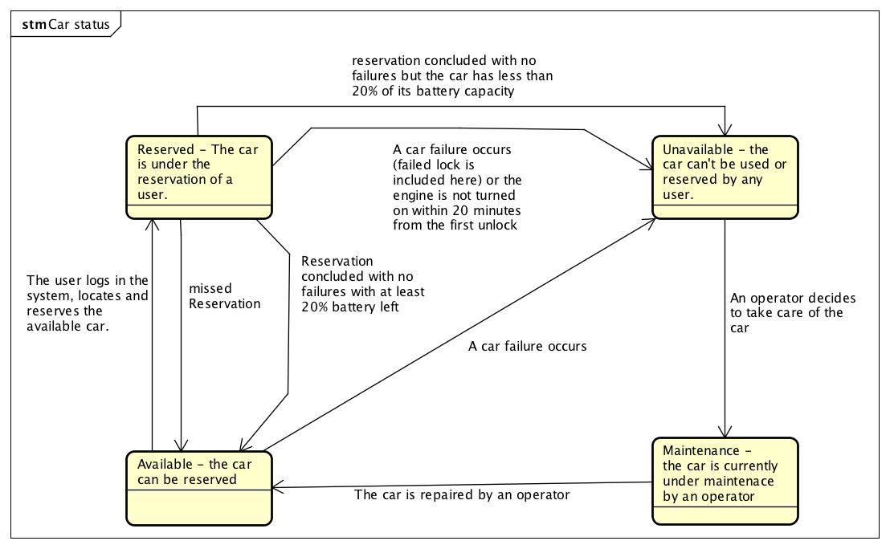
CAR STATUS: REQUIREMENTS CORE

Slide 7
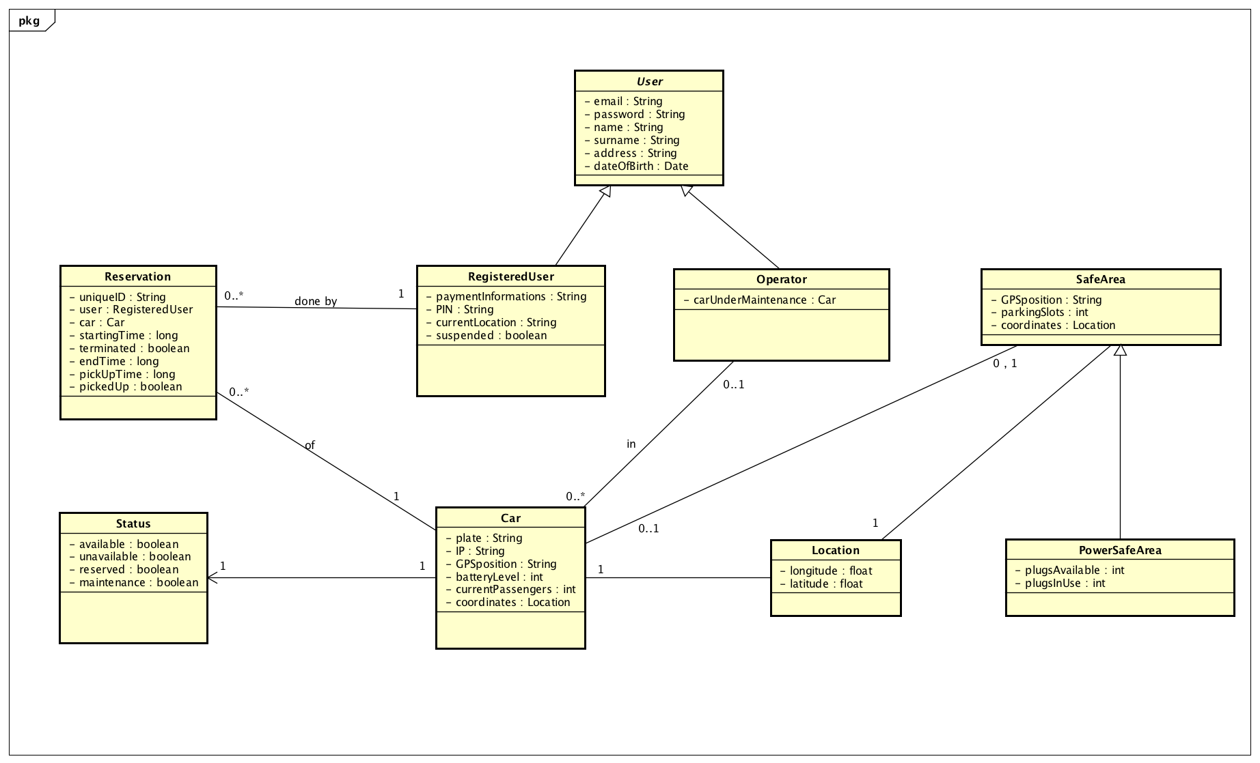
CLASS DIAGRAM

Slide 8
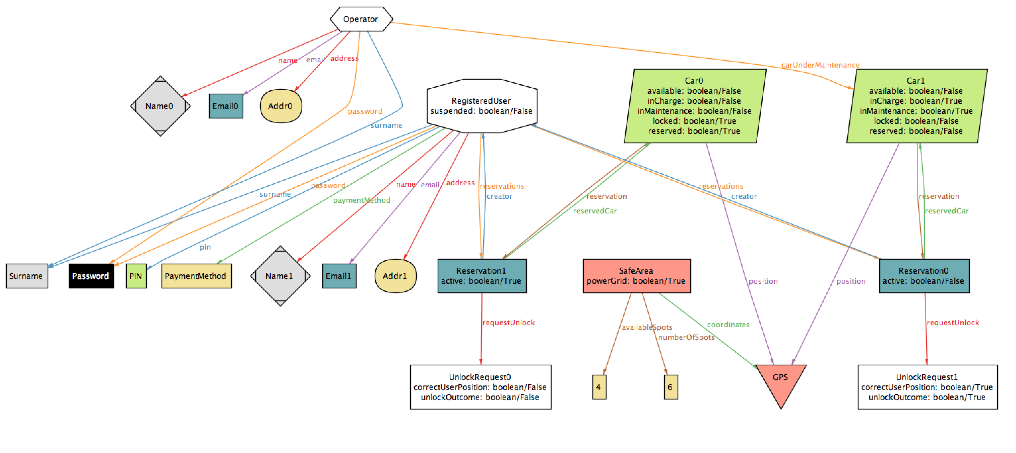
ALLOY

Slide 9
QUESTIONS?

